Slide 1
What is an Operating System?
An Operating System is a program that manages the computer hardware. It also provides a basis for application programs and acts as an intermediary between the computer user and the computer hardware.
A program that acts as an intermediary between a user of a computer and the computer hardware
The operating system controls the hardware and coordinates its use among the various application programs for the various users.
We can also view a computer system as consisting as consisting of hardware, software, and data.
Dept. of CSE(CS), MSRIT

Slide 2
What Operating System do?
Defining Operating System
No universally accepted definition of what an OS:
Operating systems exist to offer a reasonable way to solve the problem of creating a usable computing system.
The fundamental goal of computer systems is to execute user programs and to make solving user problems easier.
Since bare hardware alone is not particularly easy to use, application programs are developed.
** These programs require certain common operations, such as those controlling I/O devices.
** The common functions of controlling and allocating resources brought together into one piece of software: the Operating System
Dept. of CSE(CS), MSRIT

Slide 3
What Operating System do?
Defining operating system(Cont..)
A simple viewpoint is that it includes everything a vendor ships when you order the operating system. The features that are included vary greatly across systems:
**Some systems take up less than a megabyte of space and lack even a full-screen editor.
**Some systems require gigabytes of space and are based entirely on graphical windowing systems.
A more common definition , and the one that we usually follow, is that the operating system is the one program running at all times on the computer—usually called the kernel.
Along with the kernel, there are two other types of programs:
** System programs, which are associated with the operating system but are not necessary part of the kernel.
** Application programs, which include all programs not associated with the operation of the system.
Dept. of CSE(CS), MSRIT

Slide 4
What Operating System do?
Defining Operating System(Cont..)
The emergence of mobile devices, have resulted in an increase in the number of features that constituting the operating system.
Mobile operating systems often include not only a core kernel but also middleware—a set of software frameworks that provide additional services to application developers.
For example, each of the two most prominent mobile operating systems—Apple’s iOS and Google’s Android—feature a core kernel along with middleware that supports databases, multimedia and graphics.
Dept. of CSE(CS), MSRIT

Slide 5
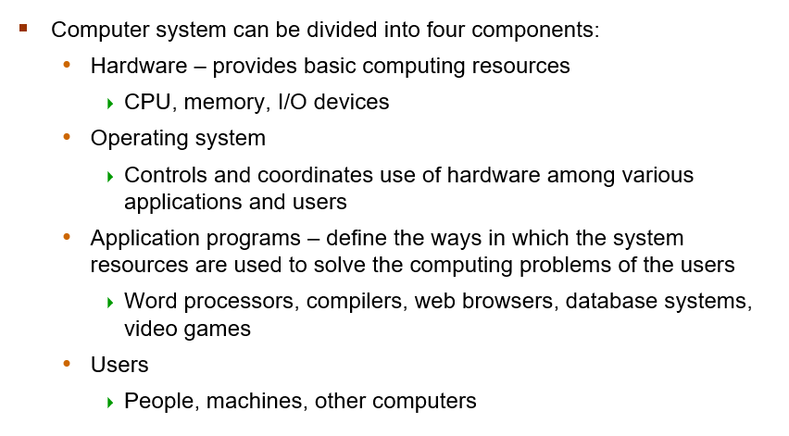
Computer System Architecture
Dept. of CSE(CS), MSRIT

Slide 6
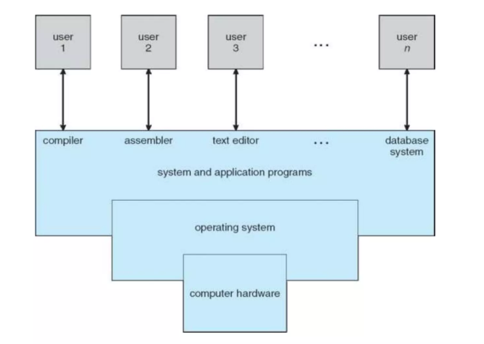
Abstract view of the components of a computer system
Fig: Abstract view of the components of a computer system
Dept. of CSE(CS), MSRIT

Slide 7
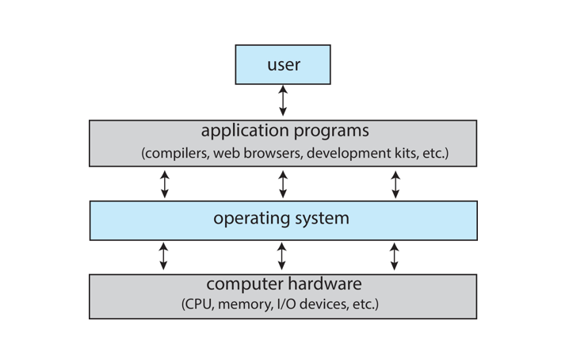
Abstract view of the components of a computer system
Dept. of CSE(CS), MSRIT

Slide 8
What Operating Systems DO
Operating system goals:
Execute user programs and make solving user problems easier
Make the computer system convenient to use
Use the computer hardware in an efficient manner
An operating system provides the means for proper use of these resources in the operation of the computer system.
An operating system is similar to a government. Like a government, it performs no useful function by itself. It simply provides an environment within which other programs can do useful work.
To understand more fully the operating system’s role, we need to explore operating systems from two viewpoints:
** The user
** The system
Dept. of CSE(CS), MSRIT

Slide 9
What Operating System do?
User View
The user’s view of the computer varies according to the interface being used:
Single user computers(e.g PC, Workstations) :Such systems are designed for one user to monopolize its resources. The goal is to maximize the work(or play) that the user is performing. The operating system is designed mostly for ease of use and good performance.
Dept. of CSE(CS), MSRIT

Slide 10
What Operating System do?
User View
Multiuser computers(e.g mainframes, computing servers)
These users share resources and may exchange information. The operating system in such cases designed to maximize resource utilization—to assure that all available cpu time, memory and I/O are used efficiently and that no individual users takes more than their air share.
Handheld computers(e.g, smartphones and tablets): The user interface for mobile computers generally features a touch screen. The systems are resource poor, optimized for usability and battery life.
Embedded computers(e.g, computers in home devices and automobiles): The user interface may have numeric keypads and may turn indicator lights on or off to show status. The operating systems are designed primarily to run without user intervention.
Dept. of CSE(CS), MSRIT

Slide 11
What Operating System do?
System View
From the computer’s point of view, the operating system is the program most intimately involves with the hardware. There are two different views:
The operating system is a resource allocator
Manages all resources such as CPU time, memory, Secondary memory, I?O devices
Decides between conflicting requests for efficient and fair resource use
The operating system is a control program
Controls execution of programs to prevent errors and improper use of the computer.
The OS decides
Which program gets which resource
when and for how long
The main goals are:
Efficient utilization of resources
Fair allocation among users and programs
Dept. of CSE(CS), MSRIT

Slide 12
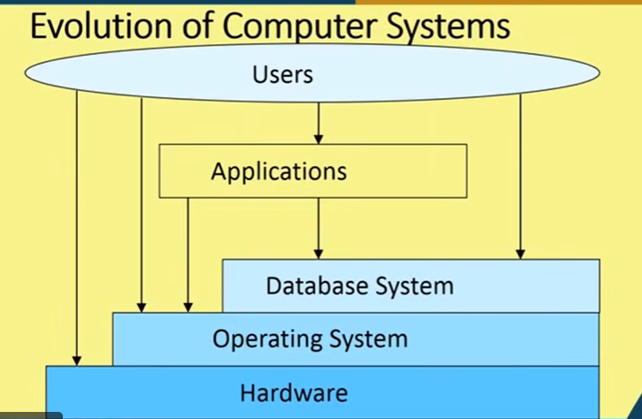
What Operating System do?
Dept. of CSE(CS), MSRIT

Slide 13
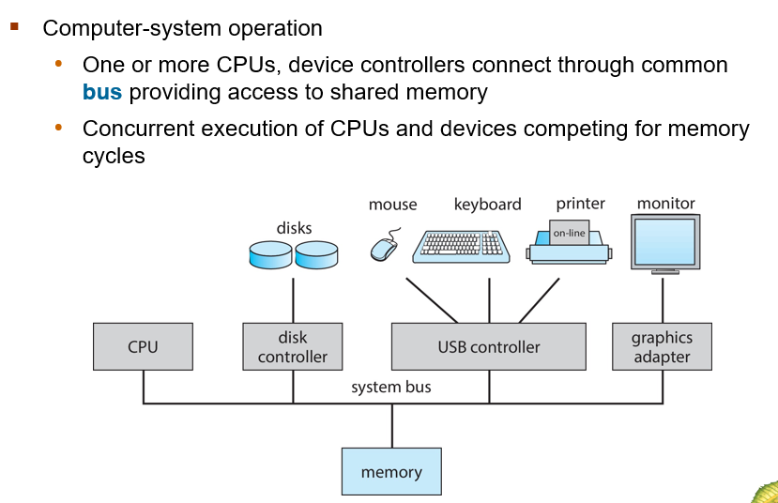
Computer System Organization
Operating System
Fig A modern computer system
Dept. of CSE(CS), MSRIT

Slide 14
Computer System Organization
A modern general-purpose computer system consists of one or more CPUs and a number of device controllers connected through a common bus that provides access to shared memory.
Each device controller is in charge of a specific type of device(for example, disk drives, audio devices, or video displays). Each device controller has a local buffer.
Cpu moves data from/to main memory to/from local buffers.
The CPU and device controllers can execute in parallel, competing for memory cycles. To ensure orderly access to the shared memory, a memory controller synchronizes access to the memory
Dept. of CSE(CS), MSRIT

Slide 15
Computer System startup
Operating System
Bootstrap Program is loaded at power-up or reboot
Typically stored in ROM or EPROM, generally known as firmware.
Initializes all aspects of system
Loads operating system kernel and starts execution.
Dept. of CSE(CS), MSRIT

Slide 16
Computer System Operation
Operating System
Once the kernel is loaded and executing, it can start providing services to the system and its users.
Some services are provided outside of the kernel, by system programs that are loaded into memory at boot time to become system processes, or system daemons that run the entire time the kernel is running.
On UNIX, the first system process is init and starts many other daemons. Once this phase is complete, the system is fully booted, and the system waits for some event to occur.
The occurrence of an event is usually signaled by an interrupt.
Dept. of CSE(CS), MSRIT

Slide 17
Interrupt handling
Interrupts:
There are two types of interrupts:
Hardware– a device may trigger an interrupt by sending a signal to the CPU, usually by way of the system bus.
Software– a program may trigger an interrupt by executing a special operation called a system call.
A software generated interrupt(sometimes called trap or exception) is caused either by an error(e.g divide by zero) or user request(e.g an I/O request).
An operating system is interrupt driven.
Dept. of CSE(CS), MSRIT

Slide 18
Common Functions of Interrupts
When an interrupt occurs, the operating system preserves the state of the CPU by storing the registers and the program counter.
Determines which type of interrupt has occurred and transfers control to the interrupt service routine(ISR)
An interrupt-service routine is a collection of routines(modules), each of which is responsible for handling one particular interrupt(e.g from a printer, from a disk)
The transfer is generally through the interrupt vector, which contains the addresses of all the service routines.
Interrupt architecture must save the address of the interrupted instruction.
Dept. of CSE(CS), MSRIT

Slide 19
Life Cycle of Interrupt
Interrupt Occurs
Interrupt Vector
Interrupt Vector Table(IVT)
ISR Address
ISR Executes(Data handling—The ISR may move from Controller’s local buffer into main memory)
Resume task
Dept. of CSE(CS), MSRIT

Slide 20
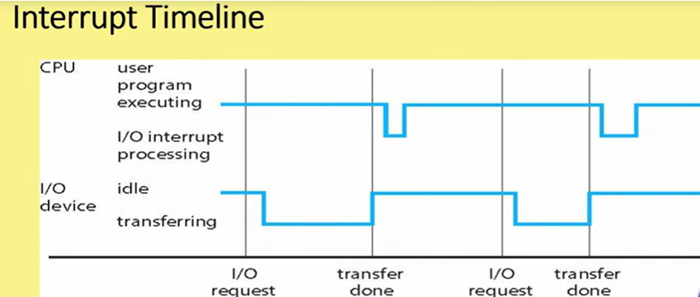
Interrupts
Dept. of CSE(CS), MSRIT

Slide 21
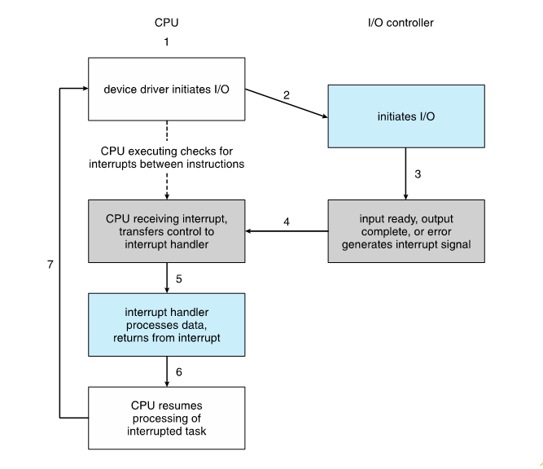
Interrupt Drive I/O cycle
Dept. of CSE(CS), MSRIT

Slide 22
I/O Structure
A general-purpose computer system consists of CPU’s and multiple device controllers that are connected through a common bus.
Each device controller is in charge of a specific type of device. More than one device may be attached. For instance, seven or more devices can be attached to the SMALL COMPUTER SYSTEMS INTERFACE(SCSI) controller.
A device controller maintains some local buffer storage and a set of special purpose registers.
The device controller is responsible for moving the data between the peripheral devices that it controls and its local buffer storage.
Typically, the operating systems have a device driver for each device controller. The device driver understands the device controller and provides the rest of the operating system with a uniform interface to the device.
Dept. of CSE(CS), MSRIT

Slide 23
I/O Structure(Contd..)
To start an I/O operation, the device driver loads the appropriate registers within the device controller.
The device controller, in turn, examines the contents of these registers to determine what action to take(such as “read” a character from the keyboard.
The controller starts the transfer of data from the device to its local buffer. Once the transfer of data is complete, the device controller informs the device driver via an interrupt that it has finished its operation.
The device driver then returns control to the operating system, possibly returning the data or a pointer to the data if the operation was a read.
For other operations, the device driver returns status information.
Dept. of CSE(CS), MSRIT

Slide 24
I/O Structure
Two Methods of Handling I/O
Blocking I/O: CPU waits until the I/O operation is completed before continuing execution.
Non-blocking I/O: CPU continues execution immediately after starting I/O and is informed later through an interrupt when the operation completes.
Dept. of CSE(CS), MSRIT

Slide 25
I/O Structure
Direct Memory Access Structure:
Interrupt-driven I/O is fine for moving small amounts of data but can produce high overhead when used for bulk data movement such as disk I/O
To solve this problem, DMA is used.
*** After setting up the buffers, pointers, and counters for the I/O device, the device controller transfers an entire block of data directly to or from its own buffer storage to memory, with no intervention by the CPU.
*** Only one interrupt is generated per block, to tell the device driver that the operation has completed. While the device controller is performing these operations, the CPU is available to accomplish other work.
Some high-end systems use switch rather bus architecture. On these systems, multiple components can talk to other components concurrently, rather than computing for cycles on a shared bus. In this case, DMA is even more effective.
Dept. of CSE(CS), MSRIT

Slide 26
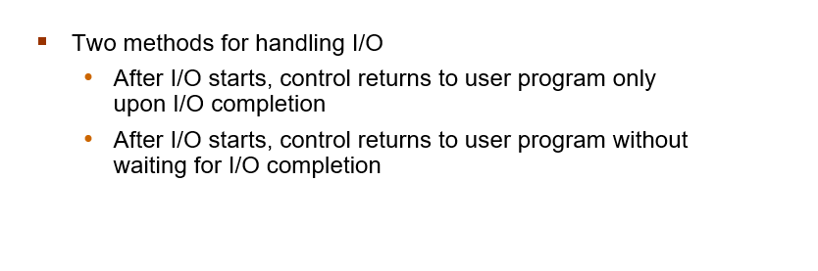
I/O Structure
Dept. of CSE(CS), MSRIT

Slide 27
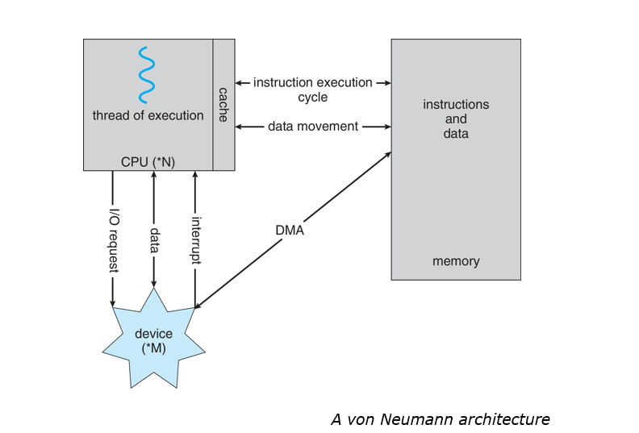
How a modern computer works
Dept. of CSE(CS), MSRIT

Slide 28
Storage Structure
Storage Structure:
Main memory- the only large storage media that the CPU can access directly
** Random access
** Typically volatile
Secondary storage—extension of main memory that provides large nonvolatile storage capacity
** Hard disks- rigid metal or glass platters covered with magnetic recording material
&&Disk Surface is logically divided into tracks, which are subdivided into sectors.
&& The disk controller determines the logical interaction between the device & computer.
** Solid-state disks—faster than hard disks, nonvolatile
&& various technologies
&& Becoming more popular
Tertiary storage
Dept. of CSE(CS), MSRIT

Slide 29
Storage Structure
Storage Definition
The basic unit of computer storage is the bit. A bit can contain one of 2 values, 0 and 1. All other storage in a computer is based on bits.
A byte is 8 bits, and most computers it is the smallest convenient chunk of storage.
A less common term is word, which is a given computer architecture’s native unit of bits
Dept. of CSE(CS), MSRIT

Slide 30
Storage Structure
Computer storage, along with most computer throughput, is generally measured and manipulated in bytes and collections of bytes.
Computer manufactures often round off these numbers and say that a megabyte is 1 million bytes and a gigabyte is 1 billion bytes.
Networking measurements are an exception to this general rule; they are given in bits(because networks move data a bit at a time).
Dept. of CSE(CS), MSRIT

Slide 31
Storage Structure
Storage Hierarchy
Storage systems organized in hierarchy
**Speed
**Cost
**Volatility
Caching—copying information from “slow” storage into faster storage system;
**Main memory can be viewed as a cache for secondary storage
Device Driver for each device controller to mange I/O
**Provides uniform interface between controller and kernel.
Dept. of CSE(CS), MSRIT

Slide 32
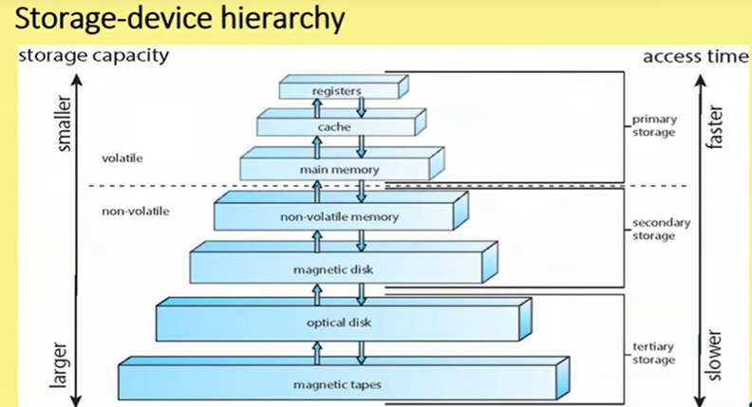
Storage Structure
Dept. of CSE(CS), MSRIT

Slide 33
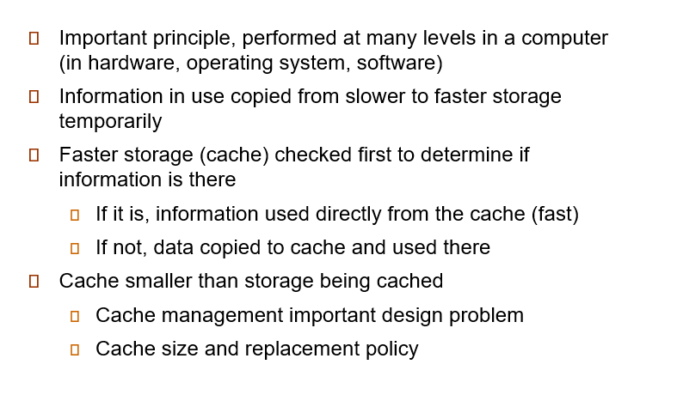
Storage Structure
Caching
Dept. of CSE(CS), MSRIT

Slide 34
Computer System Architecture
Single general-purpose processor
**Most systems have special-purpose processors as well
Multiprocessors systems
**Also known as parallel systems, tightly-coupled systems
** Advantages include:
&Increased Throughput
&Economy of scale
& Increased reliability—graceful-degradation/fault-tolerance
Two types:
**Symmetric Multiprocessing—Each processor performs all tasks
** Asymmetric Multiprocessing—Each processor is assigned a specific task.
Dept. of CSE(CS), MSRIT

Slide 35
Computer System Architecture
Advantages of Multiprocessor Systems
Increased Throughput Using multiple processors allows more work to be completed in less time, though the speed increase is less than the exact number of processors due to overhead and resource sharing.
Economy of Scale Multiprocessor systems are cost-effective because processors can share resources like memory, storage, and power supplies instead of duplicating them.
Increased Reliability If one processor fails, the system does not stop completely; other processors continue working, so the system only slows down instead of failing entirely.
Dept. of CSE(CS), MSRIT

Slide 36
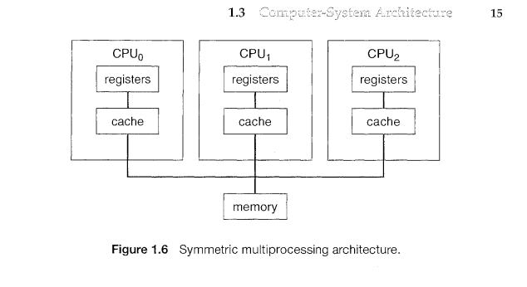
Computer System Architecture
Dept. of CSE(CS), MSRIT

Slide 37
Computer System Architecture
Multicore Systems
Most CPU design now includes multiple computing cores on a single chip. Such multiprocessor systems are termed multicore.
Multicore systems can be more efficient than multiple chips with single cores because:
** On-chip communication is faster than between-chip communication
** One chip with multiple cores uses significantly less power than multiple single core chips, an important issue for laptops as well as mobile devices.
Note– While multicore systems are multiprocessor systems, not all multiprocessor systems are multicore.
Dept. of CSE(CS), MSRIT

Slide 38
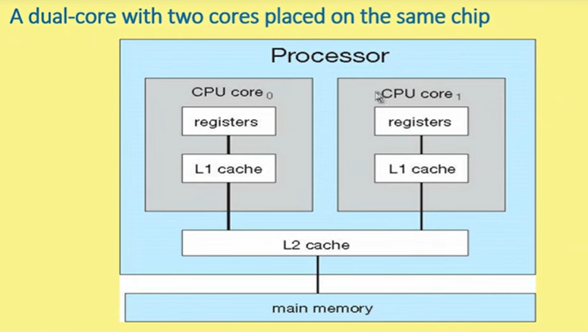
Computer System Architecture
Dept. of CSE(CS), MSRIT

Slide 39
Computer System Architecture
Clustered Systems:
Multiple Systems Working Together
A cluster consists of several independent computers connected through a network. They cooperate to provide services as if they were one system.
High Availability (Fault Tolerance)
Clusters improve reliability. If one node fails, another can take over.
Asymmetric clustering: One node runs the application, another stays in hot standby.
Symmetric clustering: All nodes run applications and monitor each other.
Shared Storage (SAN)
Nodes usually share data using a Storage Area Network (SAN), allowing all machines in the cluster to access the same storage resources.
Performance and Coordination
Some clusters are built for High-Performance Computing (HPC), where tasks are divided and run in parallel.
A Distributed Lock Manager (DLM) may be used to prevent conflicts when multiple nodes access shared data

Slide 40
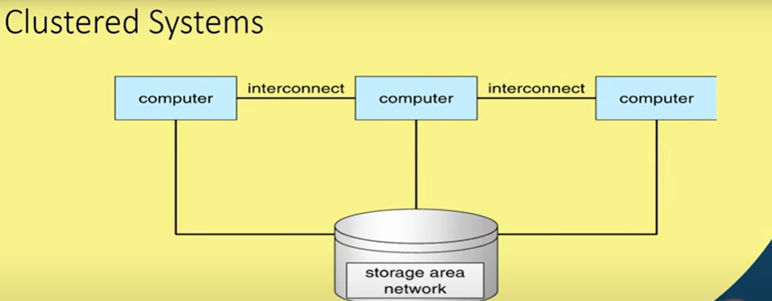
Computer System Architecture
Dept. of CSE(CS), MSRIT

Slide 41
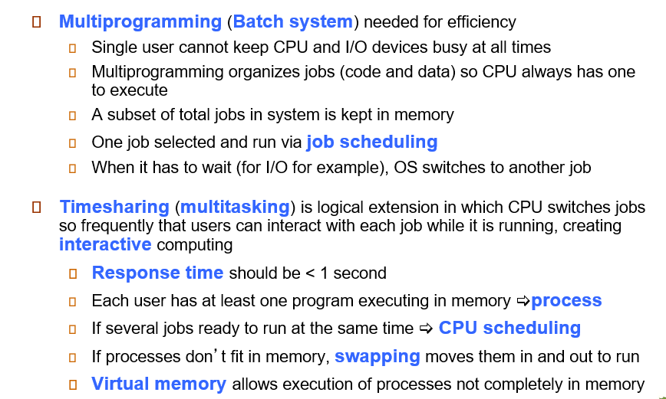
Operating System Structures
Dept. of CSE(CS), MSRIT

Slide 42
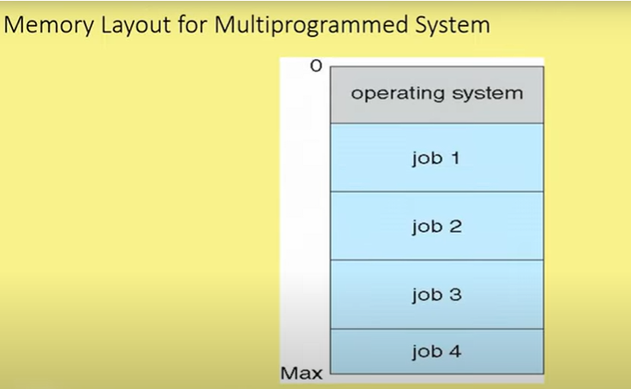
Operating System Structures
Dept. of CSE(CS), MSRIT

Slide 43
Operating System Operations
Modes of operation
A mechanism that allows the OS to protect itself and other system components
Two Modes:
User Mode
Kernel Mode
Mode bit(0 0r 1 ) provided by hardware
Provides ability to distinguish when system is running user code or kernel code.
Some instructions designated as privileges, only executable in kernel mode.
System call by a user asking the OS to perform some function changes from user mode to kernel mode.
Return from a system call resets the mode to user mode.
Dept. of CSE(CS), MSRIT

Slide 44
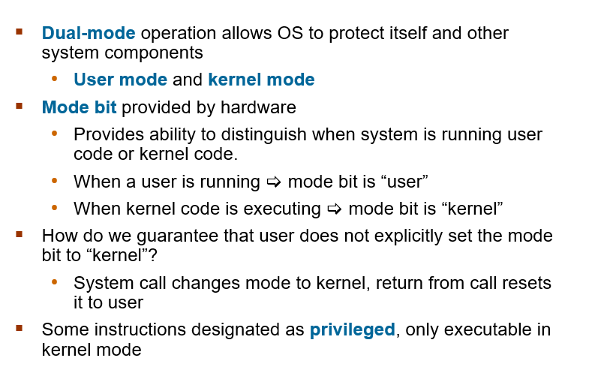
Dual mode operations
Dept. of CSE(CS), MSRIT

Slide 45
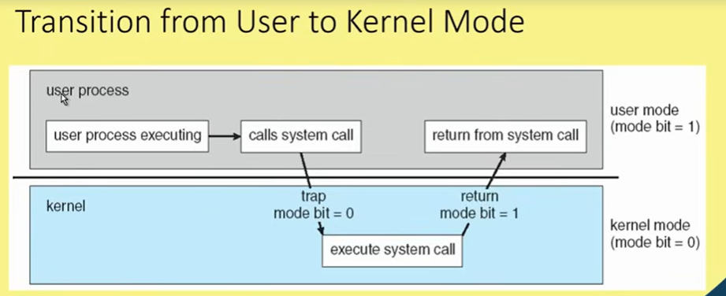
Operating System Operations
Dept. of CSE(CS), MSRIT

Slide 46
Operating System Operations
Timer:
To prevent process to be in infinite loop(process hogging resources), a timer is used, which is a hardware device.
Timer is a counter that is decremented by the physical clock.
Timer is set to interrupt the computer after some time period.
Operating system sets the counter(privileged instruction)
When counter reaches the value zero and interrupt is generated.
The OS sets up the value of the counter before scheduling a process to regain control or terminate program that exceeds allotted time.
Dept. of CSE(CS), MSRIT

